Slide 1
Psychology
For Nursing
MEMORY AND FORGETTING
Assist. Lec. Doaa M. Bachi

Slide 2
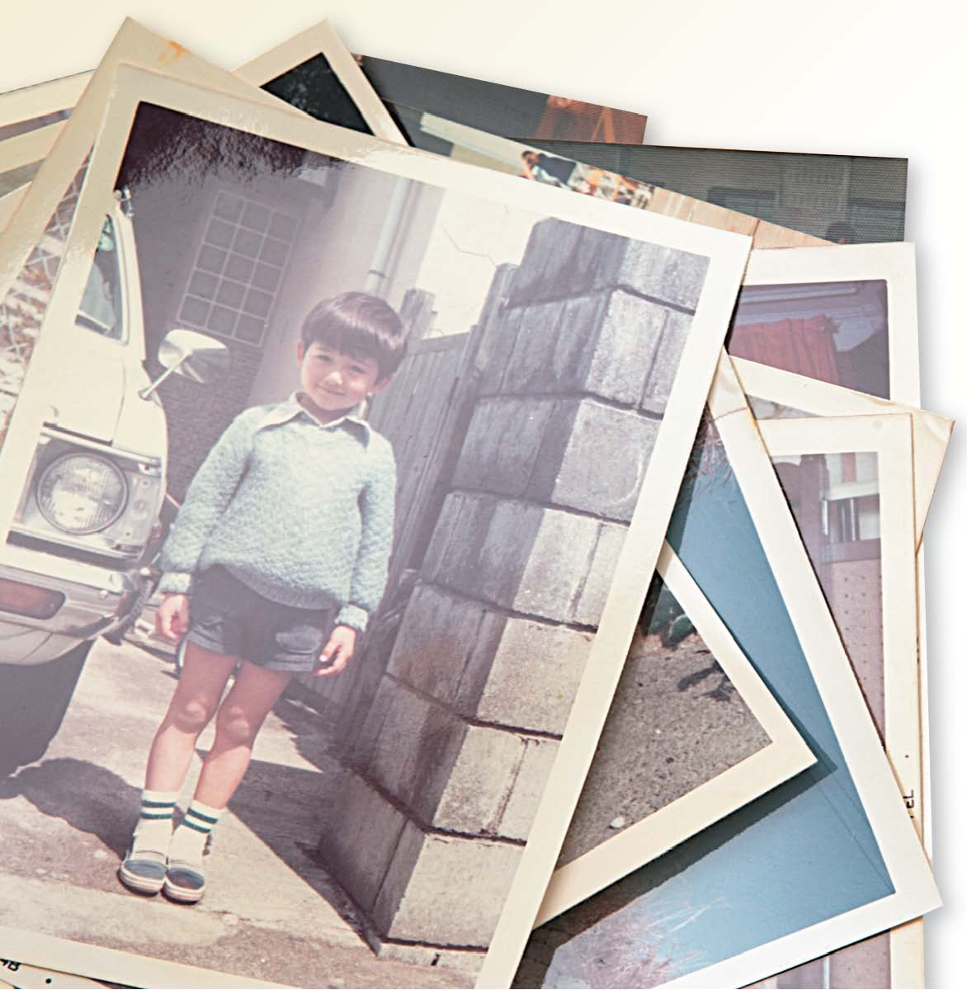
Memory The ability of an organism to record information about things or events with the facility of recalling them later at will.
Notes:
–

Slide 3
Components Of Memory
Memory involves four basic components or factors
learning
Retention
Recall Or Retrieval
Recognition

Slide 4
1. Learning
It is the process of registering impressions or acquiring new knowledge, skills, attitudes, and so on.
2. Retention
Is ability to keep things in mind and remember

Slide 5
3. Recall
This is the act of remembering something. Recall is greatly affected by emotions and motivation both at the time of learning and subsequently
4. Recognition
Is awareness of previous experience, It is complete familiarity without any mistake

Slide 6
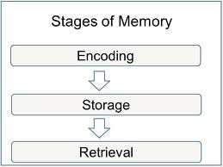
How Does Memory Work?

Slide 7
The information gets into our brains in a way that allows it to be stored. Encoding is the first stage of processing information.
1. Encoding
Encoding is based on perception and is the first step to creating a memory.
During encoding memories are developed in the hippocampus by using the language of electricity and chemicals.
When we create new memories with words and images it adds strength to our encoding abilities.

Slide 8
Encoding
Visual and Acoustic Codes
One type of code is visual.
People use visual codes when they form a mental picture.
Another type of code is acoustic.
People use acoustic codes when they use sound.
Semantic Codes
Another type of code is semantic.
A semantic code represents information in terms of its meaning.
Notes:
–

Slide 10
2. Storage
Storage is the maintenance of encoded information.
It is the second process of memory.
Maintenance Rehearsal
Elaborative Rehearsal
A more effective way to remember new information is to relate it to information you already know.
This method is called elaborative rehearsal.
It is widely used in education.
Mechanical or rote repetition of information in order to keep from forgetting it is called maintenance rehearsal.
Notes:
–

Slide 11
3. Retrieval
Retrieval is the process of getting information out of memory.
Retrieval cues are stimuli that can be used to help retrieve memories.
Retrieval is the third stage of processing information.
Notes:
–

Slide 12
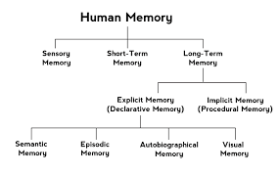
Types of Memory

Slide 13
1. Sensory Memory
Sensory memory is the first stage of information storage.
It consists of the immediate, initial recording of data that enter through the senses.
sensory memory: The brief storage (in memory) of information experienced by the senses; typically only lasts up to a few seconds.

Slide 14
Psychologists believe that each of the five senses has a register.
Mental pictures we form of visual stimuli are called icons, which are held in a sensory register called Iconic Memory.
The rare ability to remember visual stimuli over long periods of time is called Eidetic Imagery.
Mental traces of sounds are held in a mental sensory register called Echoic Memory.
Haptic Memory :This refers to memories involving the sense of touch

Slide 15
2. Short-Term Memory
Also called working memory, short-term memory is memory that holds information briefly before it is either stored in long-term memory or is forgotten.
The Primacy and Recency Effects
The Primacy Effect is the tendency to recall the initial item or items in a series.
The tendency to recall the last item or items in a series is called the Recency Effect.
Notes:
–

Slide 16
Chunking
The organization of items into familiar or manageable units is called chunking.
Interference
Interference occurs when new information appears in short-term memory and takes the place of what was already there.
It is the bridge between sensory memory and long-term memory.

Slide 17
Reading Check
Find the Main Idea
Why is short-term memory also called working memory?
Answer: because information must be in short-term memory in order to be remembered and manipulated

Slide 18
3. Long-Term Memory
Long-term memory is the third and final stage of information storage.
It is the stage of memory capable of large and relatively permanent storage.
Long-term memories can be categorized as either Explicit or Implicit memories
Notes:
–

Slide 19
Explicit Memory
Explicit memory, also known as conscious or declarative memory, involves memory of facts, concepts, and events that require conscious recall of the information.
Explicit memories can be either Semantic (abstract, fact-based) or Episodic (based on a specific event).

Slide 20
Episodic memory
Episodic memory is memory of a specific event.
A flashbulb memory is a memory of an important and intense event.
Examples of flashbulb memory: the memory of the terrorist attacks?????
Semantic Memory
Semantic memory is the memory of facts, words, and concepts.
Episodic and semantic memories are both examples of explicit memory, which is a memory of specific information.

Slide 21
Implicit Memory
Implicit memory is memory of things that are implied, or not clearly stated.
Implicit memory includes practiced skills and learned habits.
Skills learned often stay with people for a lifetime, even if they do not use them very often.

Slide 22
Reading Check
Summarize
What are the three main types of memory?
Answer: sensory , short , and Long-Term Memory

Slide 24
Forgetting
Forgetting: Is inability to recall a learnt topic or inability recognize a seen object.
Forgetting means failure at any time to recall an experience when attempting to do so or to perform an action previously learned.

Slide 25
Forgetting
Forgetting can occur at any one of the three stages of memory.
Information encoded in sensory memory decays almost immediately unless it is transferred into short-term memory.
Short-term memory will disappear after only 10 to 12 seconds unless it is transferred into long-term memory.
Information stored in short-term memory is lost when it is displaced by new information.
The most familiar and significant cases of forgetting involve the inability to use information in long-term memory.

Slide 27
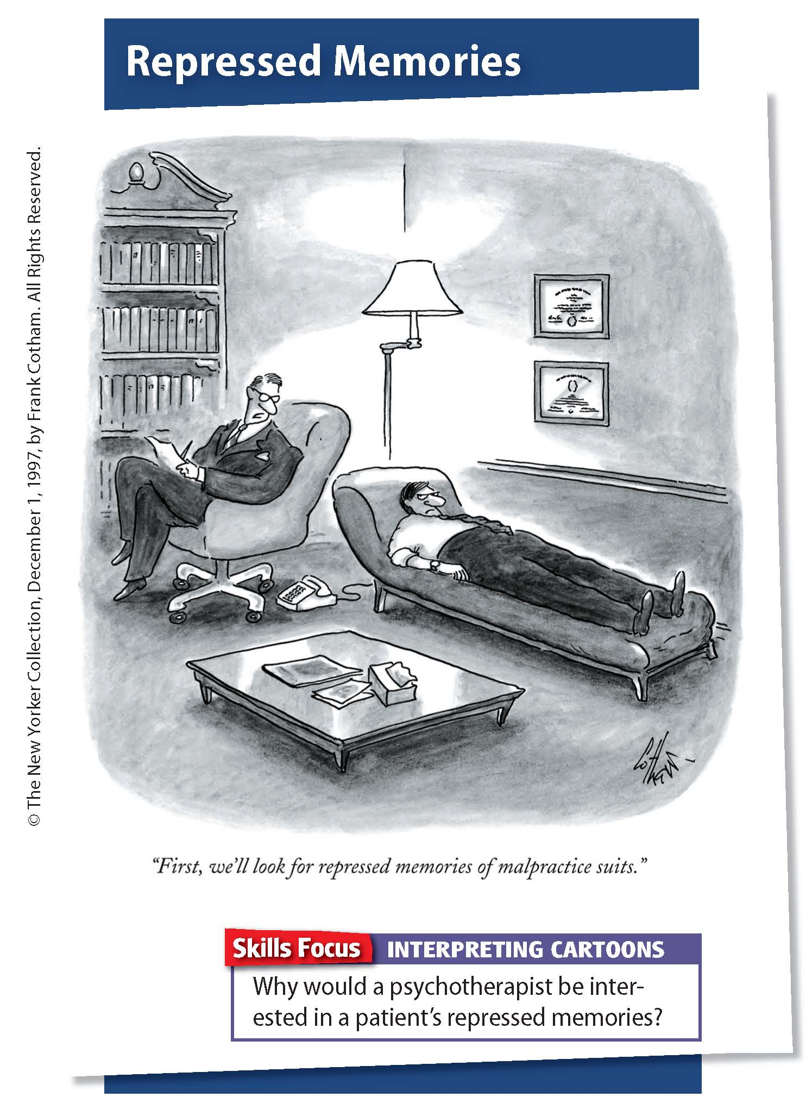

Slide 28
Causes of forgetting
1. Inadequate Impression at the Time of Learning:
The reason for inadequate impression is lack of attention and inadequate learning will is necessary for good memory
2. Decay: memories may fade or erode

Slide 29
3. Interference:
One type of learning interface with the learning of another type is called theory of interference.
There are two types of interface, proactive interface and retroactive interface:
(a) Proactive interference: When something learnt earlier distrusts recall of something you are learning how
(b) Retroactive interference: When learning now makes it harder to recall something you learned earlier.

Slide 30
4. Lack of Rest and Sleep
5. Poor Health and Defective Mental State
6. Nature of the Material Learned: Amount of forgetting also varies with the nature of the material learned
7. Methods Used to Learn:
8. Raise in Emotion: Emotion plays an important role in learning and forgetting. Sudden rise of emotions blocks the recall. During the high emotional state, blood sugar level is impaired. To maintain the balance internal gland produces cartisole that disturbs memory cells.

Slide 31
9. Entropy through disuse: Older experience the weaker its memory
10. It may result due to severe injury.
11. Repression of experiences having guilt shame or frustration

Slide 32
Reading Check
Recall
What are the five types of forgetting discussed in this section?
Answer: decay, repression, retrograde amnesia, anterograde amnesia.

Slide 33
Methods for Improving Memory
Focus Your Attention
Avoid Cramming
Structure and Organize
Utilize Mnemonic Devices
Elaborate and Rehearse
Visualize Concepts
Relate New Information to Things You Already Know
Read Out Loud
Get Some Sleep

